Slide 1



University of Illinois, Urbana Champaign
Gies College of Business
Gies Web Analytics
Optimizing Gies websites to enhance user insights and support data-driven MarCom strategies
Created by Students of Master’s in Business Analytics

Slide 2
University of Illinois, Urbana Champaign
Gies College of Business
Agenda
Executive Summary
Business Proposals
Business Goal
Reports & Trends
Challenges
Key Performance Indicators
Tip: Use links to go to a different page inside your presentation.
How: Highlight text, click on the link symbol on the toolbar, and select the page in your presentation you want to connect.
Strategic Plan
Team Learnings
Requirements
Know the Team

Slide 3



University of Illinois, Urbana Champaign
Gies College of Business
Overview
Enhance Gies Business and Online websites by analyzing user behavior to improve engagement, accessibility, and conversions
Current Status
Limited user insights, segmentation, analytics configuration, and marketing data integration hinder Gies domains ability to optimize strategies and drive conversions.
Executive Summary
Vision
The vision is to elevate the user experience on the Gies Business and Gies Online domains, drive higher conversions through personalized strategies, and amplify marketing impact with data-driven insights.
BACK TO AGENDA PAGE

Slide 4

University of Illinois, Urbana Champaign
Gies College of Business
BACK TO AGENDA PAGE
 | Gies Business | Gies Online
New Users | 268K | 408K
Returning Users | 59K | 41K
Avg. Time Spent | 1m 10s | 32s
Home Page Views | 52K | 196K
Desktop vs Mobile | 65% vs 35% | 32% vs 68%
Executive Summary
Last 90 Days - Aug 22, 2024 to Nov 22, 2024

Slide 5




University of Illinois, Urbana Champaign
Gies College of Business
Business Goals
Web Traffic Analysis
Optimize Experience
User Segmentation
Analyze traffic and conversion paths to optimize navigation
Configure Analytics to improve experience
Analyze spends and user journeys
BACK TO AGENDA PAGE

Slide 6








BACK TO AGENDA PAGE
University of Illinois, Urbana Champaign
Gies College of Business
Lack of User Behaviour Insights
Segmentation of Traffic
Marketing Spend Integrations
Challenges
Google Analytics Configurations

Slide 7

University of Illinois, Urbana Champaign
Gies College of Business
Strategic Plan
Objectives | Analytics Setup and Configurations | Enhanced Tracking Implementation | User Behavior Analysis | Data Integration & Improvement
Action Steps | Configure Google Analytics setup by enhancing tracking using UTM and page parameters | Implement Page Funnel Tracking, Click tracking on CTA’s | Perform drop off Analysis, user segmentation | Integrate marketing data, add business vs online domains, monitor KPI’s and setup alerts
Key Performance Indicator | Visits, Sessions, Page Views, Bounce Rates, Application Starts/ Completes, Click Interactions, Impressions, Conversion Rates, Traffic Stats and more | Visits, Sessions, Page Views, Bounce Rates, Application Starts/ Completes, Click Interactions, Impressions, Conversion Rates, Traffic Stats and more | Visits, Sessions, Page Views, Bounce Rates, Application Starts/ Completes, Click Interactions, Impressions, Conversion Rates, Traffic Stats and more | Visits, Sessions, Page Views, Bounce Rates, Application Starts/ Completes, Click Interactions, Impressions, Conversion Rates, Traffic Stats and more
BACK TO AGENDA PAGE

Slide 8
University of Illinois, Urbana Champaign
Gies College of Business
Where We Are Now
"At this stage, we have identified opportunities to enhance the digital experience on the Gies Business and Gies Online web applications and are progressing toward the implementation and planning phases."
BACK TO AGENDA PAGE

Slide 9


SWOT Analysis
University of Illinois, Urbana Champaign
Gies College of Business
S | W | O | T
Strengths | Weaknesses | Opportunities | Threats
Enhanced technical expertise in web inspection, data tracking and analysis. Proficient in proposing actionable, data-driven measurement solutions. | Challenges in aligning tracking variables with goals. Which areas of the business need strengthening? | Leverage newfound GA4 and technical skills to projects. New market trends and needs that could be meet? | Rapid evolving Digital space and growth. Dependence on accurate data tracking.
BACK TO AGENDA PAGE

Slide 10



BACK TO AGENDA PAGE
Requirements
University of Illinois, Urbana Champaign
Gies College of Business
UNDERSTANDING BUSINESS
OBJECTIVES
GOALS AND KPI’S IDENTIFICATION
EXISTING SETUP EVALUATION
PERFORM PRELIMINARY SWOT ANALYSIS
GATHER REQUIRED DOCUMENTATION/ SDR
DIMENSIONS & METRICS ALIGNMENT

Slide 11

University of Illinois, Urbana Champaign
Gies College of Business
BACK TO AGENDA PAGE
Page Funnel & Section Tracking | Drop Off Point Analysis
Defined URL Tracking | Advanced UTM & Hierarchy Tracking
Comprehensive Click Tracking | Business vs. Online Domain Differentiations
Proposed Solutions

Slide 12
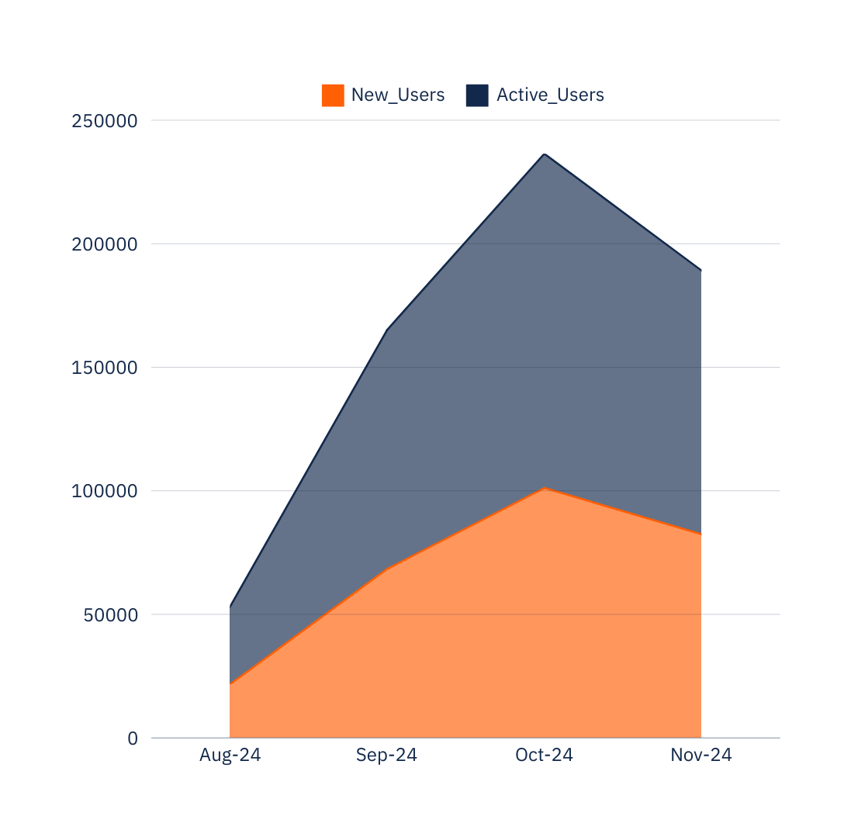
University of Illinois, Urbana Champaign
Gies College of Business
Trend Report
USERS
Gies Business New Users vs Active Users Overtime
Active Users increased by ~300% in Oct-24 from Aug-24 and similar trend is followed by New users which indicates New prospects are interested to join Gies.
BACK TO AGENDA PAGE
MONTH
Gies Business Only Last 90 Days - Aug 22, 2024 to Nov 22, 2024

Slide 13

University of Illinois, Urbana Champaign
Gies College of Business
Direct Traffic & Google
39.5% & 37.4% Sessions
Key Performance Indicators
Page View & User Eng Events
26.4% & 20.1% Events
Graduate Apply Conversions
89.5% conversions
BACK TO AGENDA PAGE
Gies Business Only Last 90 Days - Aug 22, 2024 to Nov 22, 2024

Slide 14

University of Illinois, Urbana Champaign
Gies College of Business
Exploring web Analytics and digital world
Technical expertise to understand the way web tracking works
Team collaboration fostered strong cross-cultural teamwork and exchanging ideas effectively.
Data-Driven solutions proposed actionable measurement plans, turning insights into strategies
Adaptability to shared innovative ideas and developed skills for impactful contributions.
Learnings
BACK TO AGENDA PAGE

Slide 15

University of Illinois, Urbana Champaign
Gies College of Business
BACK TO AGENDA PAGE
Aditya Agarwal
Aarushi Nanda
Lasya Venkata Lalpet
Zixiao Liu
Yifei Wang
Get In Touch

Slide 16

University of Illinois, Urbana Champaign
Gies College of Business
THANK YOU

